Slide 1

PYTHON PIRATES
AKSHATA | GAYATHIRI | NEHA | HEMA
Notes:
© Copyright Showeet.com – Creative & Free PowerPoint Templates

Slide 2
OBJECTIVE
01
What is that we are trying to achieve from this Hackathon ?
Data analysis of Hospital Database using Python based on questions provided.
Focus on writing optimized code and using different function using Python.
Produce additional data analysis.
Make use of functions that are not part of our Python Training.
Make use of Agile methodology for implementation.
Use Git and GitHub for centralized repository where users can upload, manage code and make synchronistic edits.
To showcase our work done using power point presentation.
Notes:
© Copyright Showeet.com – Creative & Free PowerPoint Templates

Slide 3
Overview
Python Hackathon
85 Questions
30 Functions
4 Pirates
6 Skills
72 Additional Questions
10 Libraries
We completed all 85 questions as assigned by the hackathon requirements.
We used 10 different libraries in our analysis.
Additional data analysis – 72 additional questions written.
30 different functions used in this exercise.
6 different technologies we used like Trello, Jupyter Notebook, Python, Git, GitHub and PyCharm.
Notes:
© Copyright Showeet.com – Creative & Free PowerPoint Templates

Slide 4

Agile Kanban Methodology
Notes:
© Copyright Showeet.com – Creative & Free PowerPoint Templates

Slide 5
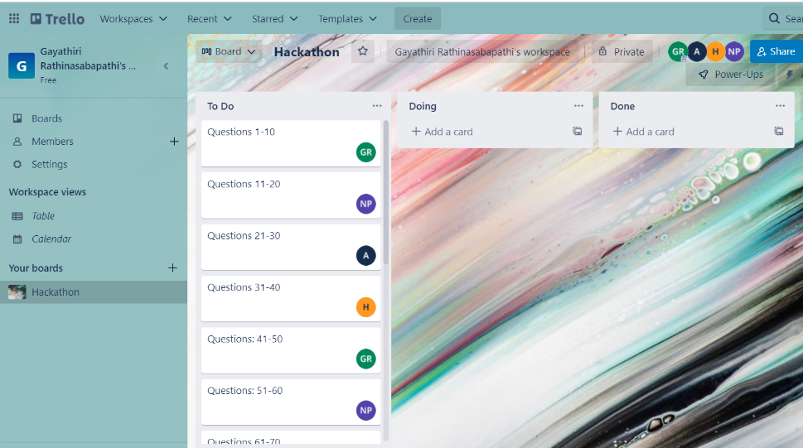
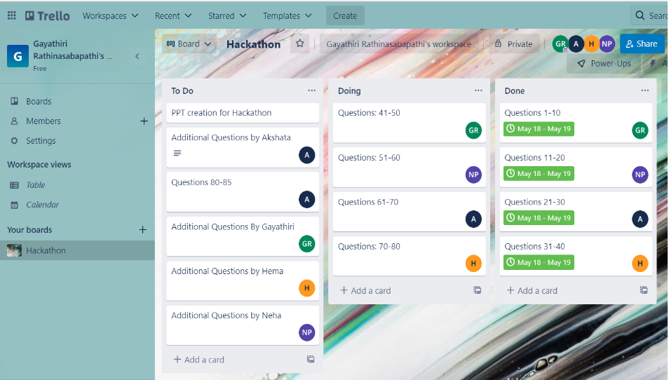
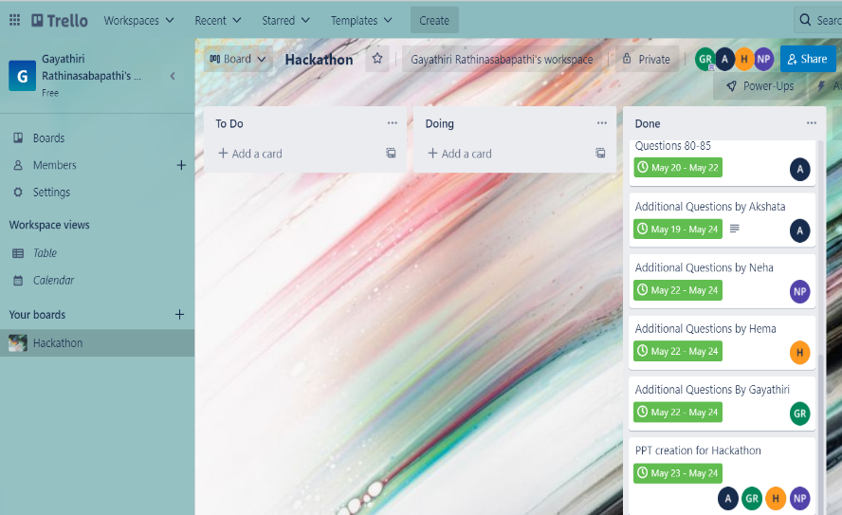
Agile Kanban - Trello
02
What is Kanban Methodology?
A visual approach to project management where teams create physical representations of their tasks, often using sticky notes on whiteboards (or online apps like Trello). Tasks are moved through predetermined stages to track progress and identify common roadblocks. Is a better option if you intend to print your document
In Progress
Complete
Notes:
© Copyright Showeet.com – Creative & Free PowerPoint Templates

Slide 6
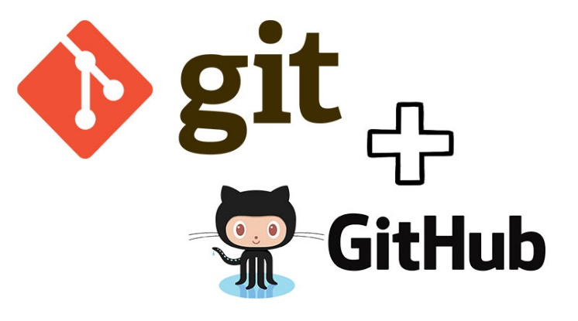
Git & GitHub
Notes:
© Copyright Showeet.com – Creative & Free PowerPoint Templates

Slide 7
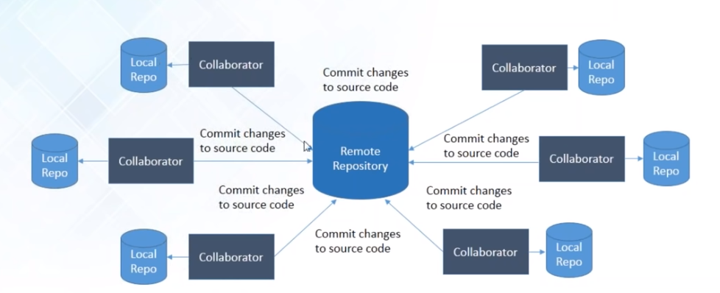
Git & GitHub
03
What is Git?
Git is a version control system used for tracking changes in computer files. It is generally used for source code management in software development.
Git is used to tracking changes in the source code.
The distributed version control tool is used for source code management.
It allows multiple developers to work together.
It supports non-linear development through its thousands of parallel branches.
Notes:
© Copyright Showeet.com – Creative & Free PowerPoint Templates

Slide 8
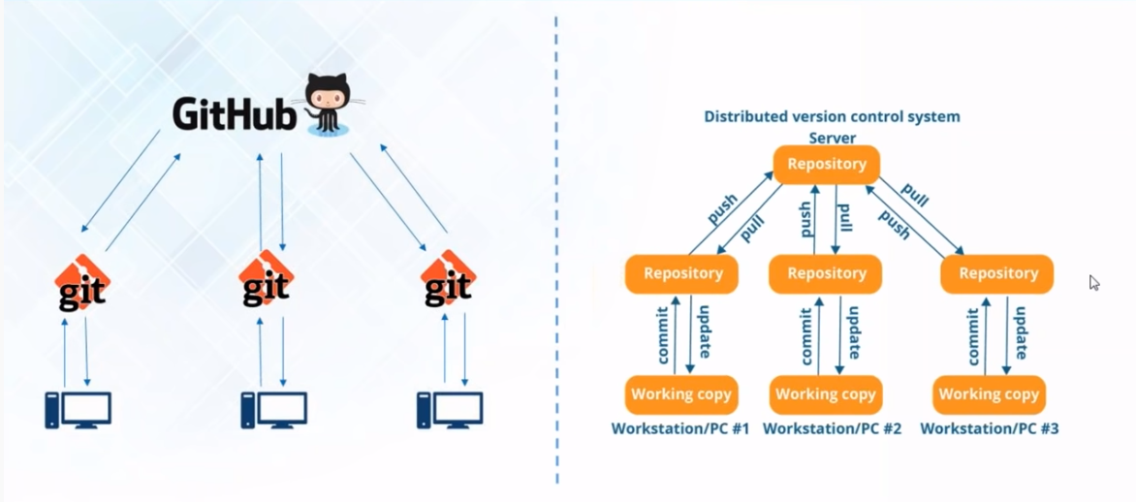
Git & GitHub
03
What is GitHub?
GitHub is a Git repository hosting service that provides a web-based graphical interface. It is the world’s largest coding community. Putting a code or a project into GitHub brings it increased, widespread exposure. Programmers can find source codes in many different languages and use the command-line interface, Git, to make and keep track of any changes…
GitHub helps every team member work together on a project from any location while facilitating collaboration. You can also review previous versions created at an earlier point in time.
Notes:
© Copyright Showeet.com – Creative & Free PowerPoint Templates

Slide 9
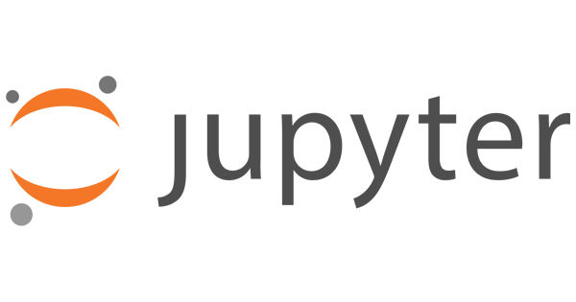
JUPYTER Notebook
Notes:
© Copyright Showeet.com – Creative & Free PowerPoint Templates

Slide 10
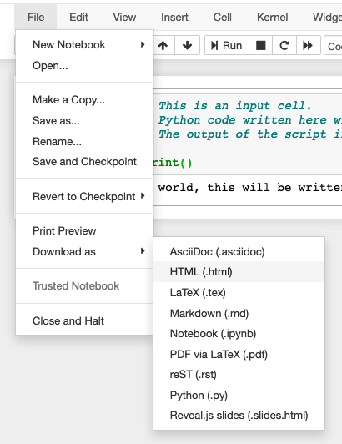
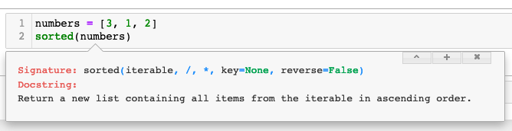
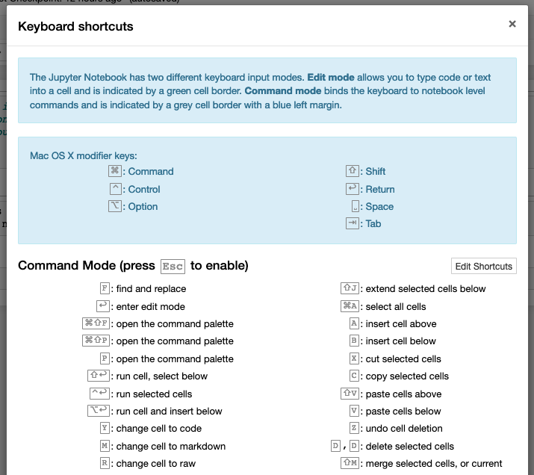
JUPYTER Notebook
04
What is Jupyter Notebook?
Jupyter Notebook is an open-source web application that allows combining code with text, visualization, equations, and analysis.
Its cell-by-cell nature allows splitting of every possible logical step, easy to modify and revert changes.
Self-living documents: Jupyter files can be downloaded in multiple formats. No need to set up Python or any programming environment in the remote host.
One of the effective features of Jupyter is its simple documentation pop-up. If we have a function shift+tab opens a popup displaying documentation of that function.
Jupyter notebook is more useful when we use keyboard shortcuts. Help>Keyboard shortcuts will open a popup showing all the shortcut keys. They also can be changed with Help>Edit keyboard shortcuts.
Notes:
© Copyright Showeet.com – Creative & Free PowerPoint Templates

Slide 11
List of Libraries & Functions Used
LIBRARIES | FUNCTIONS | FUNCTIONS
NUMPY | SPLIT() | COUNT()
PANDAS | GROUP BY | MAX() MIN()
MATPLOTLIB | RANGE() | MERGE()
SEABORN | UPPER(), LOWER() | SLICE()
MATH | LEN() | SUM()
DATETIME | INPUT() | SORTED()
VENN3 | DICT | SIZE()
RE | LIST() | MEAN()
RANDOM | PRINT() | VALUE_COUNT()
LIST | DUMMIES() | NUNIQUE()
Notes:
© Copyright Showeet.com – Creative & Free PowerPoint Templates

Slide 12



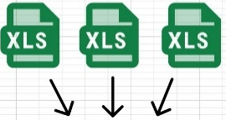
Challenges Faced and How We Overcame
Working together in GIT
Understanding and
resolving errors
For many of us, working in git was a new experience but fortunately, we had one expert among us who guided us throughout.
To resolve any error understanding it properly is very important and we did it by discussing the error with the team. This helped us all in expanding our knowledge.
Understanding Questions
Fetching data from multiple sheets for single query
We had a brilliant team. We had multiple meetings when someone is stuck in between and tried to resolve it and move forward.
.
As our dataset had multiple sheets in an excel file it took a little time to become used to handling multiple sheets. Gradually practice made us do it with confidence.
Notes:
© Copyright Showeet.com – Creative & Free PowerPoint Templates

Slide 13
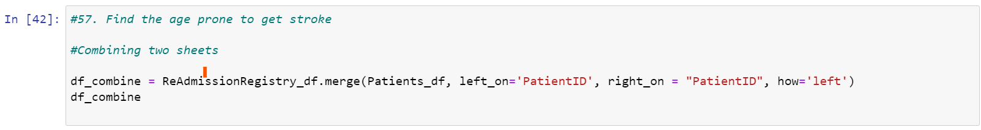
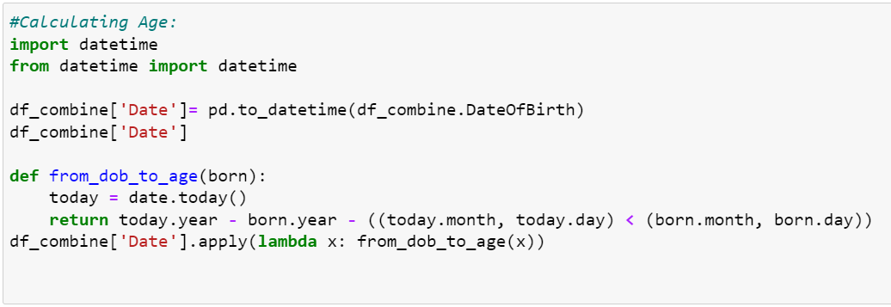

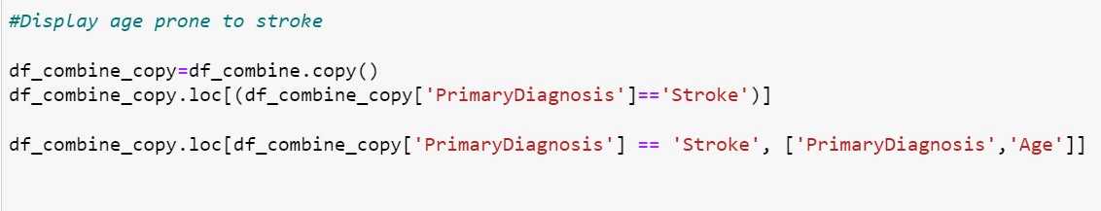
Example - Complex Question
There were multiple questions where we ran multiple steps to reach the result. Like:
Combining the columns from different sheets
Performing calculation part to generate a new column
Adding this new column into the sheet
And finally displaying the final output
Notes:
© Copyright Showeet.com – Creative & Free PowerPoint Templates

Slide 14
Some Best Practices That Helped Us While Writing PYTHON Code
Keep the notebook simple with organized and readable code. It becomes easy to work with and understand in minimum time.
Remove the dead code immediately. Eventually, a single line of code becomes overhead to keep track of. Less n proper code is equal to less stress for us.
Use the right data structures and functions to understand their benefits and limitations.
Use the object-oriented paradigm if writing code for Python. Python is an object-oriented language, and everything in Python is an object.
Notes:
© Copyright Showeet.com – Creative & Free PowerPoint Templates

Slide 15
Making a difference in your work is not about productivity; it's about people. When you focus on others and connect with them, you can work together to accomplish great things.
John Calvin Maxwell
Notes:
© Copyright Showeet.com – Creative & Free PowerPoint Templates

Slide 16
Thank You!
Supratim Dasgupta | Namrata Kapoor
Manalle | Jyothi | meEnu | vandana
Photo credit: PeterArreola via Pixabay (Creative Commons Zero license)
Notes:
© Copyright Showeet.com – Creative & Free PowerPoint Templates

